Slide 1

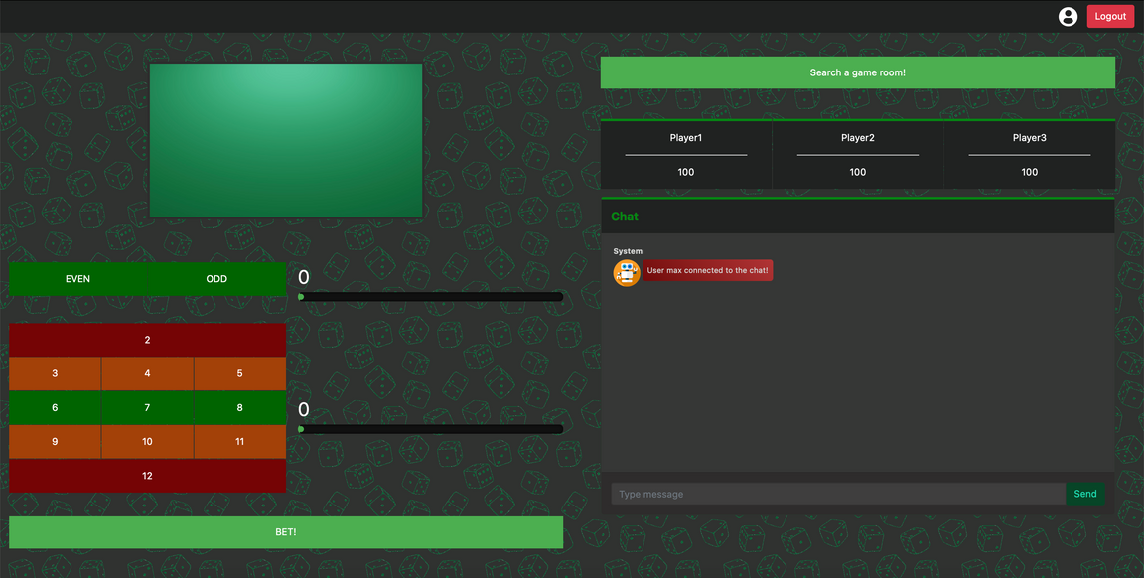
ODD BETS
A simple online dice rolling game, where the user is able to interact with other players through his choices and thanks to an easy chat service.
AVESANI DAVIDE 2060112
BRANCA MAX 2061432
IANNOLA GABRIELE 1849732
PAOLUZZI FABRIZIO 1743773
SOANNINI LORENZO 1837487

Slide 2

Introduction
For our project, we decided to realise a simple online video game, where the user is able to interact with other players through his choices and thanks to an easy chat service.
The rules of the game are quite simple: the computer is in charge of rolling two dice, and the players' goal is to guess the value of the dice returned by the end of the round.
Each attempt requires a sum of money, and the money gained at each turn is proportional to the amount submitted and on how risky the choice is.
At the end of the game, the player with the highest sum of money wins.

Slide 3


Project high-level structure
Following the microservices principles, we created a distributed system composed by containerized independent modules that communicate each other exposing REST APIs. On the other hand the clients connect through Websocket protocol and can access to the services provided.
The backend infrastructure was divided into four main components:
The main servers, that are responsible of the sharing of common data and communication with the players.
The load balancer, that automatically redirected the new users to the server with the fewest connected users.
The database, that contains all the information about players’ account, max score and number of played games.
The RNG, that generates a random number between 1 and 6 to determine the outcome of a dice roll in our game.

Slide 4
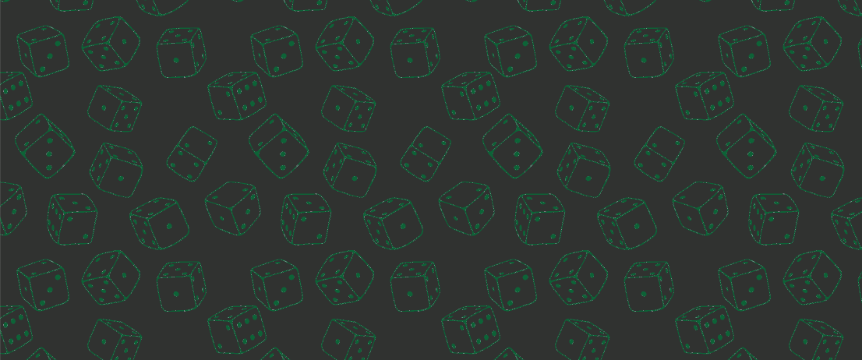
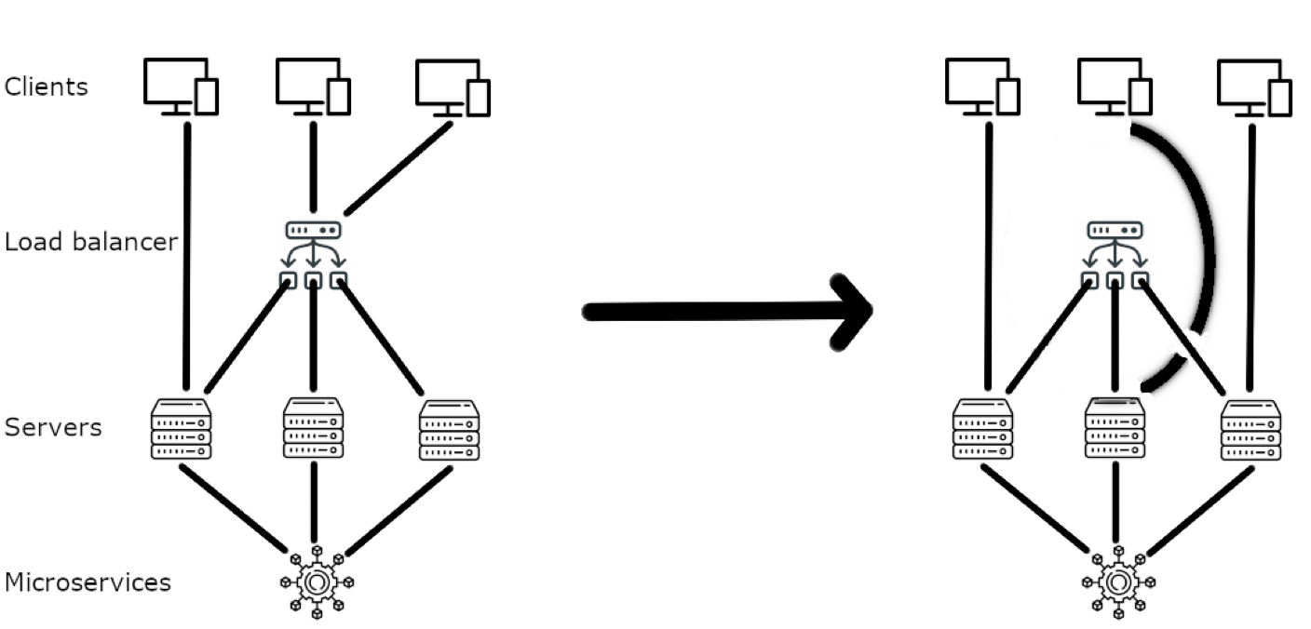
Here we report how the load balancer works:

Slide 5



Server Components
Each server node is built on some basic distributed components
RELIABLE BROADCAST
FAILURE DETECTOR
CONSENSUS

Slide 6





Technologies employed

Slide 7
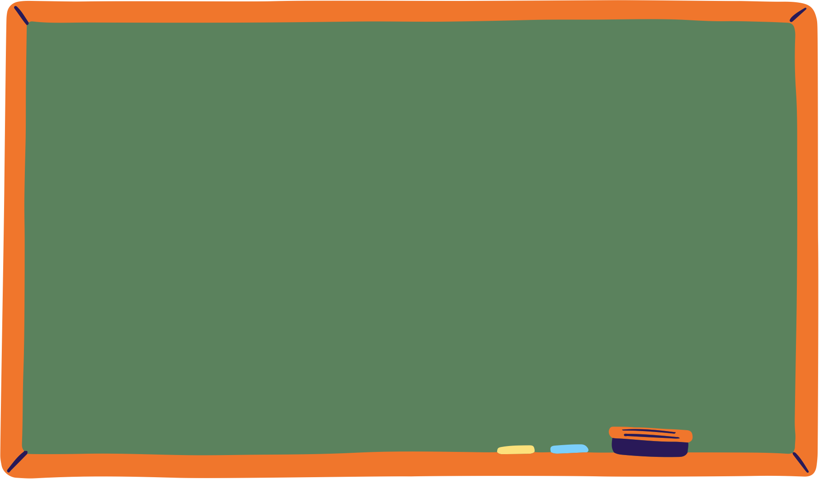











As the product owner I want a distributed system to keep the game available to players
As the product owner I want a distributed system to keep the game available to players
As a gamer I want to bet as much as I want to be more invested in the game
As a gamer I need some game mechanics to play the game
As a gamer I want to register to keep record of my progresses
As a playing user I want crashes to be avoided to keep playing the game
As a gamer I want a chat to talk with my friends

Slide 8

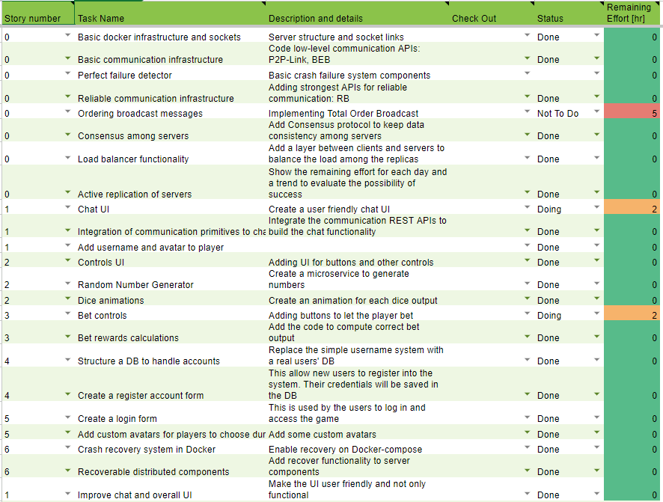

SPRINT BACKLOG

Slide 9
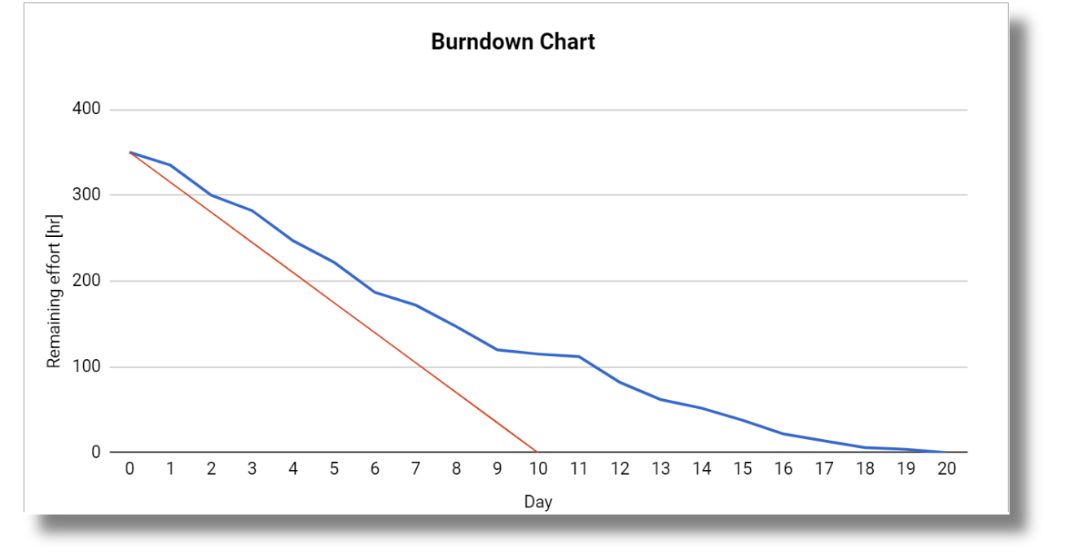

Slide 10

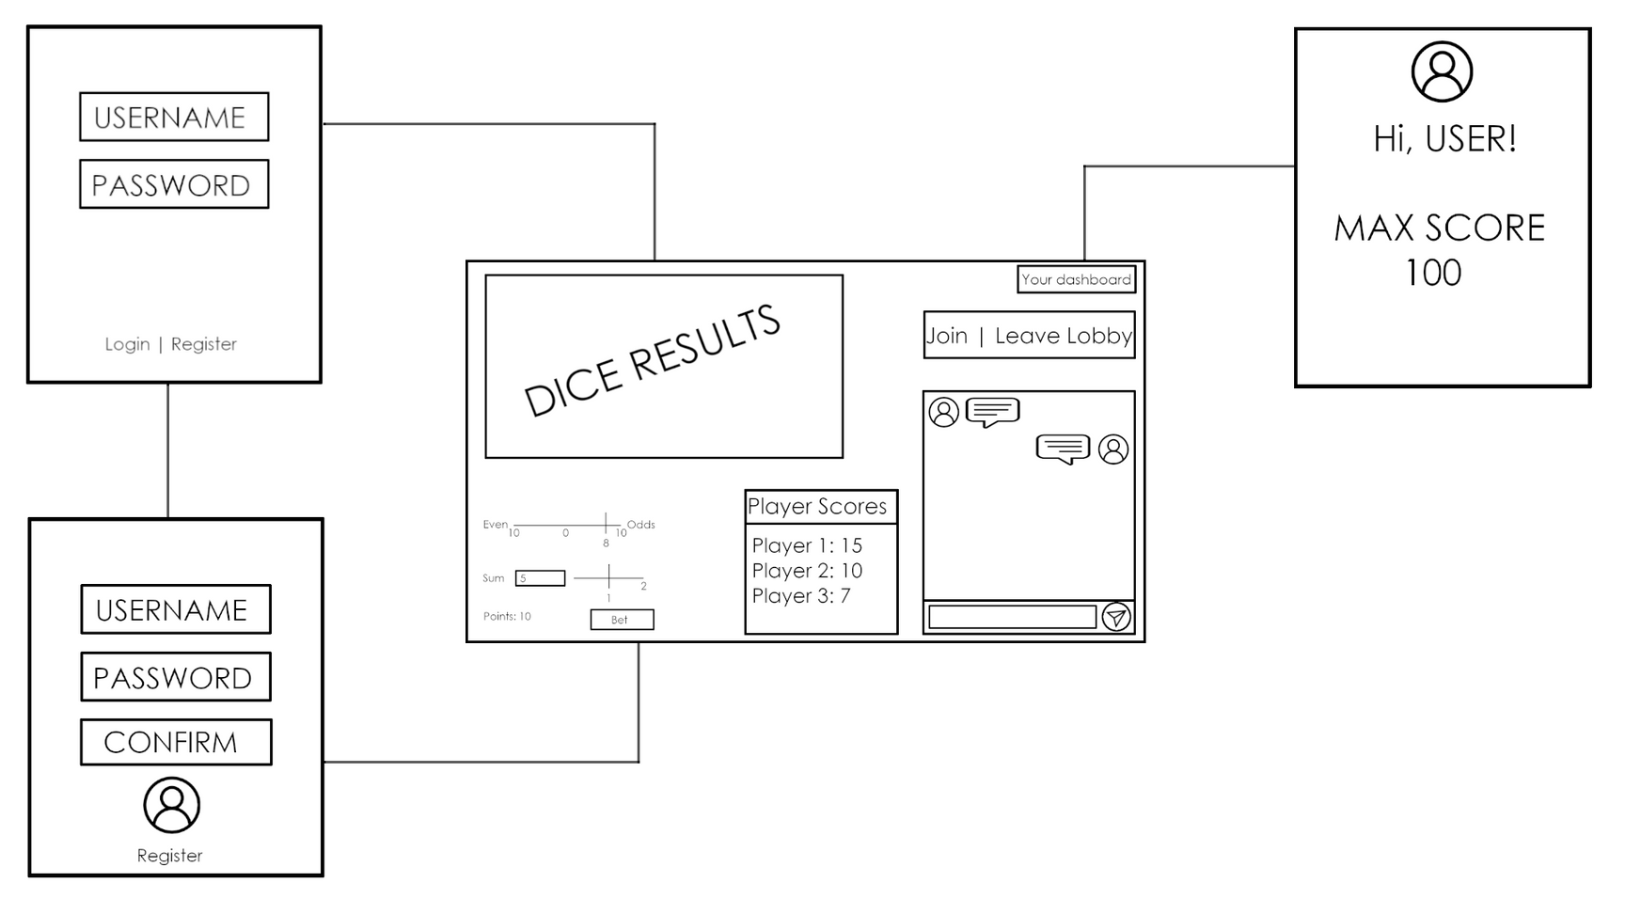
MOCKUP

Slide 11
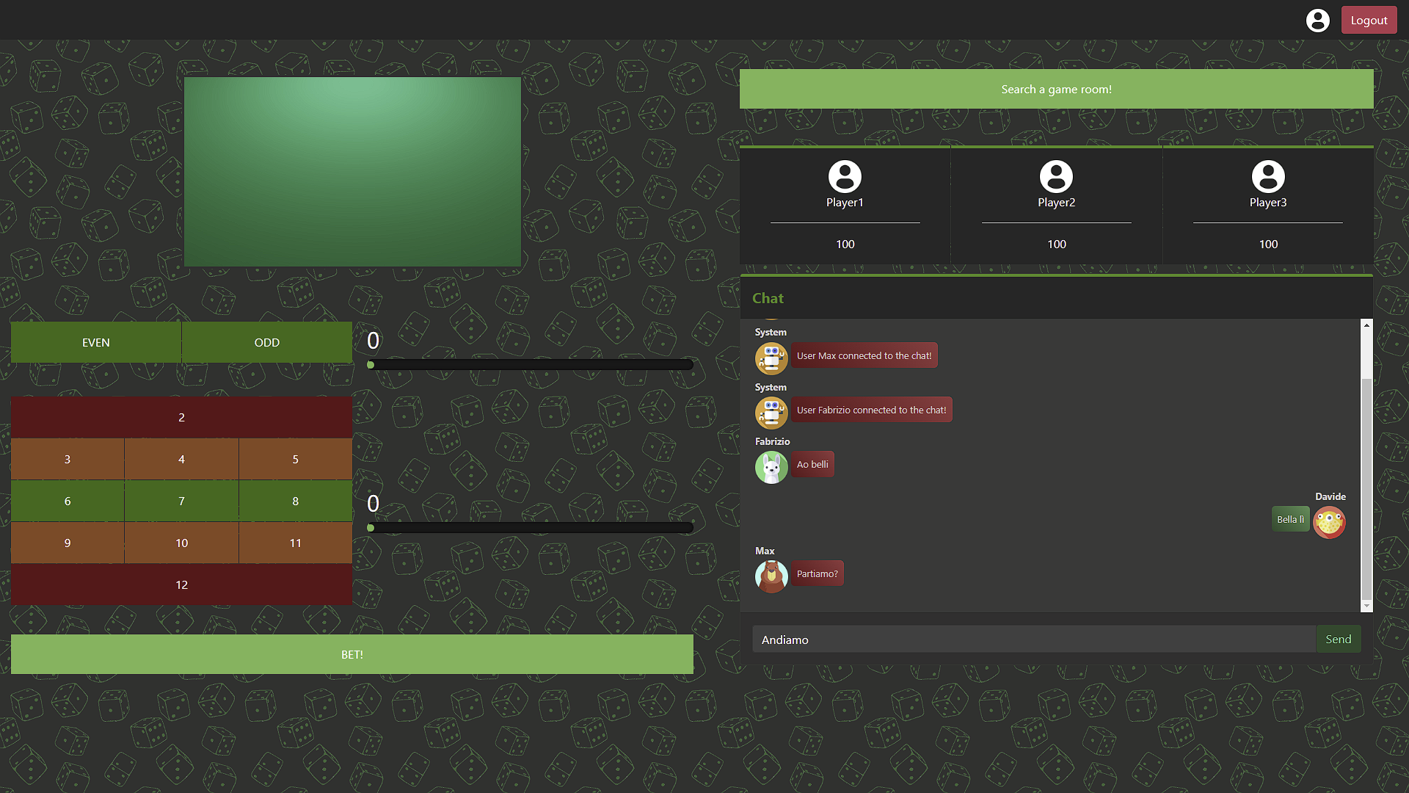

Slide 12
Function Points
We initially estimated the use of 3 ILFs and 1 EIF, 4 EIs, 2 EOs and 2 EQs
This resulted with a total of 52 UFP, with an adjusted value of 44 AFP.
Stimating the LOC/FP ratio to 15 for Python apps, we should have near 660 lines of code.
A more in-depth analysis can be found at the following link:
https://docs.google.com/spreadsheets/d/1R8lP0wEmGuiy214CRlaaB6deuhkq9MZdgdwTFpia2HM/edit#gid=1435377526

Slide 13

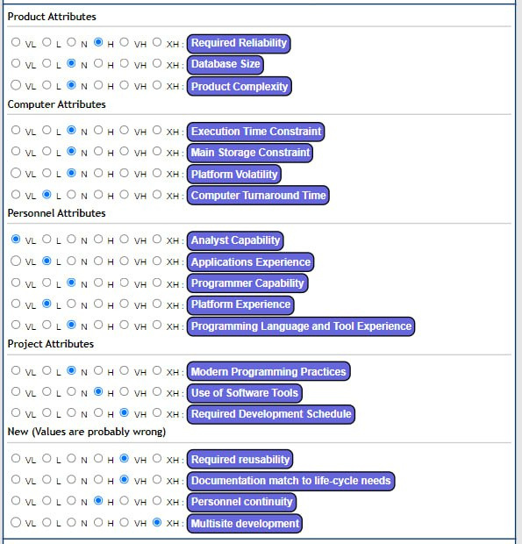
COCOMO II
Using an online tool , the estimation for our
project was of 660 LOC, with an effort of 4.28
person-month, with our team of 5 people this
results in a duration of about 3 weeks.
In the end, the duration was pretty similar, but
the total kLOC is of circa 0.9 for the Python code.
This difference can be attributed to the distributed system, which is present in the user stories but not in the calculation of Function Points.

Slide 14
THANK YOU FOR YOUR ATTENTION.

